Slide 1

Full Stack diploma
PHP

Slide 2

What is a PHP File?
PHP files can contain text, HTML, CSS, JavaScript, and PHP code
PHP code is executed on the server, and the result is returned to the browser as plain HTML
PHP files have extension ".php"
V . 2

Slide 3
What can PHP do?
PHP can generate dynamic page content
PHP can create, open, read, write, delete, and close files on the server
PHP can collect form data
PHP can send and receive cookies
PHP can add, delete, modify data in your database
PHP can be used to control user-access
PHP can encrypt data
With PHP you are not limited to output HTML. You can output images, PDF files, and even Flash movies. You can also output any text, such as XHTML and XML
V . 2

Slide 4
Why PHP?
PHP runs on various platforms (Windows, Linux, Unix, Mac OS X, etc.)
PHP is compatible with almost all servers used today (Apache, IIS, etc.)
PHP supports a wide range of databases
PHP is free. Download it from the official PHP resource: www.php.net
PHP is easy to learn and runs efficiently on the server side
V . 2

Slide 5
PHP Syntax
Basic PHP Syntax :
A PHP script can be placed anywhere in the document.
A PHP script starts with <?php and ends with ?>
<?php
// PHP code here
?>
V . 2

Slide 6
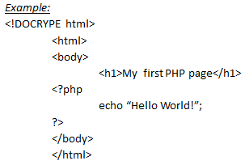
PHP Syntax
Note: PHP statement end with a semicolon (;)
V . 2

Slide 7
Comments in PHP
A comment in PHP code is a line that is not executed as a part of the program. Its only purpose is to be read by someone who is looking at the code. Comments can be used to:
Let others understand your code
Remind yourself of what you did - Most programmers have experienced coming back to their own work a year or two later and having to re-figure out what they did. Comments can remind you of what you were thinking when you wrote the code
V . 2

Slide 8
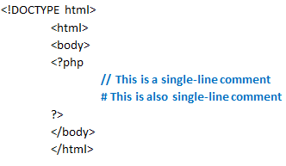
Comments in PHP
Syntax for single-line comments:
V . 2

Slide 9
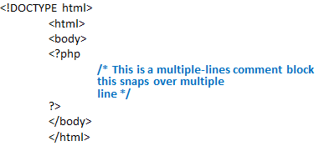
Comments in PHP
Syntax for multiple-line comments:
V . 2

Slide 10
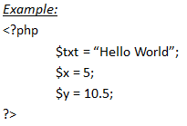
PHP Variables
Creating (Declaring) PHP Variables
In PHP, a variable starts with the $ sign, followed by the name of the variable
V . 2

Slide 11
PHP Variables
After the execution of the statements above, the variable $txt will hold the value Hello world!, the variable $x will hold the value 5, and the variable $y will hold the value 10.5. A variable can have a short name (like x and y) or a more descriptive name (age, carname, total_volume).
Note: When you assign a text value to a variable, put quotes around the value.
Unlike other programming languages, PHP has no command for declaring a variable. It is created the moment you first assign a value to it.

Slide 12
PHP Variables
Rules for PHP variables:
A variable starts with the $ sign, followed by the name of the variable
A variable name must start with a letter or the underscore character
A variable name cannot start with a number
A variable name can only contain alpha-numeric characters and underscores (A-z, 0-9, and _ )
Variable names are case-sensitive ($age and $AGE are two different variables)
V . 2

Slide 13
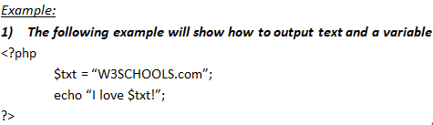
Output Variables
The PHP echo statement is often used to output data to the screen. The following example will show how to output text and a variable:
V . 2

Slide 14
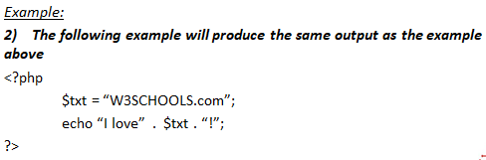
Output Variables
V . 2

Slide 15
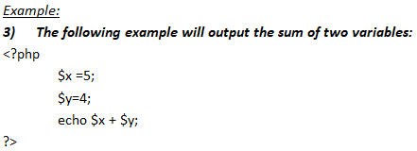
Output Variables
V . 2

Slide 16
Echo and Print Statements
With PHP, there are two basic ways to get output: echo and print. In this tutorial we use echo or print in almost every example. So, this chapter contains a little more info about those two output statements. echo and print are more or less the same. They are both used to output data to the screen. The differences are small: echo has no return value while print has a return value of 1 so it can be used in expressions. echo can take multiple parameters (although such usage is rare) while print can take one argument. echo is marginally faster than print.
V . 2

Slide 17
Echo Statements
The following example shows how to output text with the echo statement:
Example:
<?php
$txt1 = “Learn PHP”;
$txt2 = “W3SCHOOLS”;
$x = 5;
$y= 4;
echo “<h2> “ . $txt1. “</h2>;
echo “Study PHP at” . $txt2 . “<br>”;
echo $x + $y;
?>
Display Variables
V . 2

Slide 18
Echo Statements
The echo statement can be used with or without parentheses: echo or echo().
The following example shows how to output text with the echo command (notice that the text can contain HTML markup):
<? Php
echo “<h2>PHP is Fun!</h2>”;
echo “Hello World!<br>”;
echo “I’m about to learn PHP<br>”;
echo “This “, “string “, “was “, “made “, “with multiple parameters.”;
?>
Display Text
V . 2

Slide 19
Print Statements
The print statement can be used with or without parentheses: print or print().
The following example shows how to output text with the print command (notice that the text can contain HTML markup):
Example:
<php
print “<h2>PHP is Fun!</h2>;
print “Hello World!<br>”;
print “I’m about to learn PHP!”;
?>
Display Text
V . 2

Slide 20
Data Types
Variables can store data of different types, and different data types can do different things.
PHP supports the following data types:
String
Integer
Float (floating point numbers - also called double)
Boolean
Array
Object
NULL
Resource
V . 2

Slide 21
Data Types
PHP String
A string is a sequence of characters, like "Hello world!".
A string can be any text inside quotes. You can use single or double quotes:
Example:
<?php
$x = “Hello World!”;
$y = ‘Hello World’;
echo $x;
echo “<br>”;
echo $y;
?>
V . 2

Slide 22
PHP String Functions
Strlen
The PHP strlen() function returns the length of a string.
Example:
<?php
echo strlen(“Hello World!”); //output 12
?>
V . 2

Slide 23
PHP String Functions
Str_word_count()
The PHP strlen() function returns the length of a string.
Example:
<?php
echo strlen(“Hello World!”); //output 12
?>
V . 2

Slide 24
Data Types
Strrev()
The PHP strrev() function reverses a string.
Example:
<?php
echo strrev(“Hello world!”); //output !dlrow olleH
?>
V . 2

Slide 25
Data Types
Strpos ()
The PHP strpos() function searches for a specific text within a string. If a match is found, the function returns the character position of the first match. If no match is found, it will return FALSE.
Example:
<?php
echo strpos(“Hello world!” , “world”); // output 6
?>
V . 2

Slide 26
Data Types
Str_replace()
Replace the text "world" with "Dolly":
Example:
<?php
echo str_replace(“world”, “Dolly”, “Hello world!”); //output Hello Dolly!
?>
V . 2

Slide 27
PHP String Functions
The PHP string functions are part of the PHP core. No installation is required to use these functions.
Function | Description
addcslashes() | Returns a string with backslashes in front of the specifed characters
addslashes() | Returns a string with backslashes in front of predefined characters
bin2hex() | Converts a string of ASCII characters to hexadecimal values
V . 2

Slide 28
PHP String Functions
Function | Description
chop() | Removes whitespace or other characters from the right end of a string
chr() | Returns a character from a specified ASCII value
chunk_split() | Splits a string into a series of smaller parts
convert_cyr_string() | Converts a string from one Cyrillic character-set to anther
convert_uudecode() | Decodes a uuencoded string
V . 2

Slide 29
PHP String Functions
Function | Description
convert_uuencoded() | Encodes a string using the uuencode algorithm
count_chars() | Returns information about characters used in a string
crc32() | Calculates a 32-bit CRC for a string
crypt() | One-way string hashing
echo() | Outputs one or more strings
V . 2

Slide 30
PHP String Functions
Function | Description
explode() | Breaks a string into an array
fprintf() | Writes a formatted string to a specified output stream
hebrev() | Converts Hebrew text to visual tex
hex2bin() | Converts a string of hexadecimal values to ASCII characters
hexrevc() | Converts Hebrew text to visual text and new lines(\n)into
V . 2

Slide 31
PHP String Functions
Function | Description
hex2bin() | Converts a string of hexadecimal values to ASCII characters
html_entity_decode() | Converts HTML entities to characters
htmlentities() | Converts characters to HTML entities
htmlspecialchars_decode() | Converts some predefined HTML entities to characters
htmlspecialchars() | Converts some predefined characters to HTML entities
V . 2

Slide 32
PHP String Functions
Function | Description
implode() | Returns a string from the elements of an array
join() | Alias of implode()
icfirst() | Converts the first character of a string to lowercase
levenshtein() | Returns the Levenshtein distance between two strings
localecony() | Returns locale numeric and monetary formatting information
V . 2

Slide 33
PHP String Functions
Function | Description
Itrim() | Removes whitespace or other characters from the left side of a string
md5 | Removes whitespace or other characters from the left side of a string
md5_file() | Removes whitespace or other characters from the left side of a string
metaphone() | Removes whitespace or other characters from the left side of a string
money_format() | Returns a string formatted as a currency string
V . 2

Slide 34
PHP String Functions
Function | Description
nl_langinfo() | Returns specific local information
nl2br() | Inserts HTML line breaks in front of each newline in a string
number_format() | Inserts HTML line breaks in front of each newline in a string
ord() | Returns the ASCII value of the first character of a string
parse_str() | Parses a query string into variables
V . 2

Slide 35
PHP String Functions
Function | Description
strcoll() | Compares two strings (locale based string comparison)
stecspn() | Returns the number of characters found in a string before any part of some specified characters are found
strip_tags() | Strips HTML and PHP tags from a string
stripcslashes() | Unquotes a string quoted with addcslashes()
stripslashes() | Unquotes a string quoted with addslashes()
V . 2

Slide 36
PHP String Functions
Function | Description
stripos() | Returns the position of the first occurrence of a string inside another string (case-insensitive)
stristr() | Finds the first occurrence of a string inside another string (caseinsensitive)
strlen() | Returns the length of a string
strnatcasecmp() | Compares two strings using a "natural order" algorithm (caseinsensitive)
strnatcmp() | Compares two strings using a "natural order" algorithm (casesensitive)
V . 2

Slide 37
PHP String Functions
Function | Description
strncasecmp() | String comparison of the first n characters (case-insensitive)
strncmp() | String comparison of the first n characters (case-sensitive)
strpbrk() | Searches a string for any of a set of characters
strpos() | Returns the position of the first occurrence of a string inside another string (casesensitive)
strrchr() | Finds the last occurrence of a string inside another string
V . 2

Slide 38
PHP String Functions
Function | Description
strtok() | Split string one by one
strtolower() | Convert all characters to lowercase
strtoupper() | Convert all characters to uppercase
strtr() | Translates certain characters in a string.
substr() | Returns a part of a string.
V . 2

Slide 39
PHP String Functions
Function | Description
substr_compare() | Compares two strings from a specified start position.
substr_count() | Counts the number of times a substring occurs in a string.
substr_replace() | Replaces a part of a string with another string
trim() | Removes whitespace and other predefined characters from both sides of a string
ucfirst() | Converts the first character of a string to uppercase
V . 2

Slide 40
PHP String Functions
Function | Description
ucwords() | Converts the first character of each word in a string to uppercase.
vfprintf() | Writes a formatted string to a specified output stream
vprintf() | Outputs a formatted string.
vsprintf() | Writes a formatted string to a variable.
wordwrap() | Wraps a string into new lines when it reaches a specific length.
V . 2

Slide 41
PHP Integer
An integer data type is a non-decimal number between -2,147,483,648 and 2,147,483,647.
Rules for integers:
An integer must have at least one digit
An integer must not have a decimal point
An integer can be either positive or negative
Integers can be specified in: decimal (base 10), hexadecimal (base 16), octal (base 8), or binary (base 2) notation
In the following example $x is an integer. The PHP var_dump() function returns the data type and value:
V . 2

Slide 42
PHP Integer
Example:
<?php
$x = 5985;
var_dump=($x);
?>
V . 2

Slide 43
PHP Float
A float (floating point number) is a number with a decimal point or a number in exponential form.
In the following example $x is a float. The PHP var_dump() function returns the data type and value:
Example:
<?php
$x = 10.365;
vat_dump($x);
?>
V . 2

Slide 44
PHP Boolean
A Boolean represents two possible states: TRUE or FALSE.
$x = true;
$y = false;
Booleans are often used in conditional testing. You will learn more about conditional testing in a later chapter of this tutorial.
V . 2

Slide 45
PHP Array
An array stores multiple values in one single variable.
In the following example $cars is an array. The PHP var_dump() function returns the data type and value:
Example:
<?php
$cars = array(“volvo”, “BMW”, “Toyota”);
var_dump($cars);
?>
V . 2

Slide 46
PHP Numbers
One thing to notice about PHP is that it provides automatic data type conversion.
So, if you assign an integer value to a variable, the type of that variable will automatically be an integer.
Then, if you assign a string to the same variable, the type will change to a string.
This automatic conversion can sometimes break your code.
V . 2

Slide 47
PHP Integers
An integer is a number without any decimal part.
2, 256, -256, 10358, -179567 are all integers. While 7.56, 10.0, 150.67 are floats.
So, an integer data type is a non-decimal number between -2147483648 and 2147483647. A value greater (or lower) than this, will be stored as float, because it exceeds the limit of an integer.
Another important thing to know is that even if 4 * 2.5 is 10, the result is stored as float, because one of the operands is a float (2.5).
V . 2

Slide 48
PHP Integers
Here are some rules for integers:
An integer must have at least one digit
An integer must not have a decimal point
An integer can be either positive or negative
Integers can be specified in three formats: decimal (10-based), hexadecimal (16-based - prefixed with 0x) or octal (8-based - prefixed with 0)
PHP has the following functions to check if the type of a variable is integer:
is_int()
is_integer() - alias of is_int()
is_long() - alias of is_int()
V . 2

Slide 49
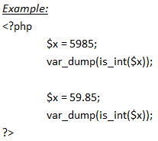
PHP Integers
V . 2

Slide 50
PHP floats
A float is a number with a decimal point or a number in exponential form.
2.0, 256.4, 10.358, 7.64E+5, 5.56E-5 are all floats.
The float data type can commonly store a value up to 1.7976931348623E+308 (platform dependent), and have a maximum precision of 14 digits.
PHP has the following functions to check if the type of a variable is float:
is_float()
is_double() - alias of is_float()
V . 2

Slide 51
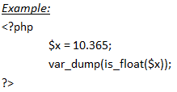
PHP floats
V . 2

Slide 52
PHP Infinity
A numeric value that is larger than PHP_FLOAT_MAX is considered infinite.
PHP has the following functions to check if a numeric value is finite or infinite:
is_finite()
is_infinite()
However, the PHP var_dump() function returns the data type and value:
V . 2

Slide 53
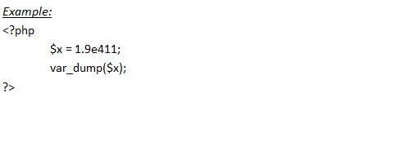
PHP Infinity
V . 2

Slide 54
PHP NaN
NaN stands for Not a Number. NaN is used for impossible mathematical operations.
PHP has the following functions to check if a value is not a number:
is_nan()
However, the PHP var_dump() function returns the data type and value:
Example:
<?php
$x = acos(8);
var_dump($x);
?>
V . 2

Slide 55
PHP Numerical Strings
The PHP is_numeric() function can be used to find whether a variable is numeric. The function returns true if the variable is a number or a numeric string, false otherwise
V . 2

Slide 56
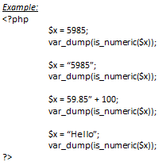
PHP Numerical Strings
V . 2

Slide 57
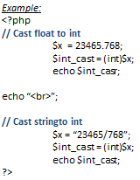
PHP Casting Strings and Floats to Integers
Sometimes you need to cast a numerical value into another data type. The (int), (integer), or intval() function are often used to convert a value to an integer.
V . 2

Slide 58
PHP Operators
Operators are used to perform operations on variables and values.
PHP divides the operators in the following groups:
Arithmetic operators
Assignment operators
Comparison operators
Increment/Decrement operators
Logical operators
String operators
Array operators
Conditional assignment operators
V . 2

Slide 59
PHP Arithmetic Operators
The PHP arithmetic operators are used with numeric values to perform common arithmetical operations, such as addition, subtraction, multiplication etc.
Operator | Name | Example | Result
+ | Addition | $x + $y | Sum of $x and $y
- | Subtraction | $x - $y | Difference of $x and $y
/ | Division | $x / $y | Quotient of $x and $y
* | Multiplication | $x * $y | Product of $x and $y
% | Modulus | $x % $y | Remainder of $x and $y
V . 2

Slide 60
PHP Assignment Operators
The PHP assignment operators are used with numeric values to write a value to a variable.
The basic assignment operator in PHP is "=". It means that the left operand gets set to the value of the assignment expression on the right.
Assignment | Same as | Description
x = y | x = y | The left operand gets set to the value of the expression on the right
x += y | x = x + y | Addition
V . 2

Slide 61
PHP Assignment Operators
Assignment | Same as | Description
x -= y | x = x - y | Subtraction
x *= y | x = x / y | Multiplication
x %= y | x = x % y | Modulus
V . 2

Slide 62
PHP Comparison Operators
The PHP comparison operators are used to compare two values (number or string):
Operator | Name | Example | Result
== | Equal | $x == $y | Returns true if $x is equal to $y
=== | Identical | $x === $y | Returns true if $x is equal to $y and they are of the same type
!= | Not equal | $x != $y | Returns true if $x is not equal to $y
V . 2

Slide 63
PHP Comparison Operators
Operator | Name | Example | Result
<> | Not equal | $x <> $y | Returns true if $x is not equal to $y
!== | Not Identical | $x !== $y | Returns true if $x is not equal to $y and they are not of the same type
> | Greater than | $x > $y | Returns true if $x is greater than $y
V . 2

Slide 64
PHP Comparison Operators
Operator | Name | Example | Result
< | Less than | $x < $y | Returns true if $x is less than $y
>= | Greater than or equal to | $x >= $y | Returns true if $x is greater than or equal to $y
<= | Less than of equal to | $x <= $y | Returns true if $x is less than or equal to $y
<=> | Spaceship | $x <=> $y | Returns an integer less than, equal to or greater than zero, depending on if $x is less than, equal to or greater than $y
V . 2

Slide 65
PHP Increment / Decrement Operators
The PHP increment operators are used to increment a variable's value.
The PHP decrement operators are used to decrement a variable's value.
Operator | Name | Description
++$x | Pre-increment | Increments $x by one, then returns $x
$x++ | Post-increment | Returns $x, then increments $x by one.
--$x | Pre-decrement | Decrements $x by one, then returns $x
$x-- | Post-decrement | Return $x, then decrements $x by one.
V . 2

Slide 66
PHP String Operators
PHP has two operators that are specially designed for strings
Operator | Name | Description | Result
. | Concatenation | $txt1 . $txt2 | Concatenation of $txt1 and $txt2
.= | Concatenation assignment | $txt1 .= $txt2 | Appends $txt2 to $txt2
V . 2

Slide 67
PHP if…else…elseif Statements
Conditional statements are used to perform different actions based on different conditions.
PHP Conditional Statements
Very often when you write code, you want to perform different actions for different conditions. You can use conditional statements in your code to do this.
In PHP we have the following conditional statements:
if statement - executes some code if one condition is true
if...else statement - executes some code if a condition is true and another code if that condition is false
if...elseif...else statement - executes different codes for more than two conditions
switch statement - selects one of many blocks of code to be executed
V . 2

Slide 68
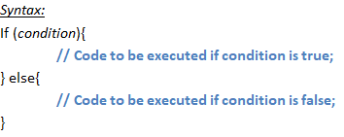
PHP if…else Statement
The if...else statement executes some code if a condition is true and another code if that condition is false.
V . 2

Slide 69
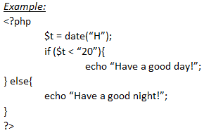
PHP if…else Statement
V . 2

Slide 70
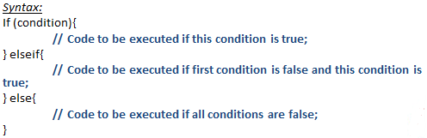
PHP if…elseif…else Statement
The if...elseif...else statement executes different codes for more than two conditions.
V . 2

Slide 71
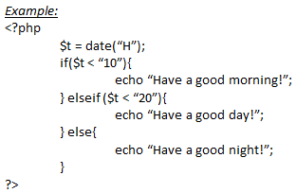
PHP if…elseif…else Statement
V . 2

Slide 72
PHP Switch Statement
The switch statement is used to perform different actions based on different conditions.
Use the switch statement to select one of many blocks of code to be executed.
V . 2

Slide 73
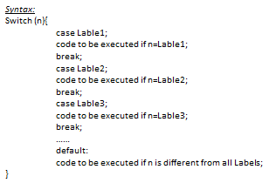
PHP Switch Statement
V . 2

Slide 74
PHP Switch Statement
This is how it works: First we have a single expression n (most often a variable), that is evaluated once. The value of the expression is then compared with the values for each case in the structure. If there is a match, the block of code associated with that case is executed. Use break to prevent the code from running into the next case automatically. The default statement is used if no match is found.
V . 2

Slide 75
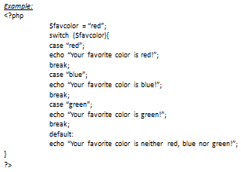
PHP Switch Statement
V . 2

Slide 76
PHP Loops
In the following chapters you will learn how to repeat code by using loops in PHP.
Often when you write code, you want the same block of code to run over and over again a certain number of times. So, instead of adding several almost equal code-lines in a script, we can use loops.
Loops are used to execute the same block of code again and again, as long as a certain condition is true.
In PHP, we have the following loop types:
while - loops through a block of code as long as the specified condition is true
do...while - loops through a block of code once, and then repeats the loop as long as the specified condition is true
for - loops through a block of code a specified number of times
foreach - loops through a block of code for each element in an array The following chapters will explain and give examples of each loop type.
V . 2

Slide 77
PHP While Loop
The while loop - Loops through a block of code as long as the specified condition is true. The while loop executes a block of code as long as the specified condition is true.
Syntax:
While {
// Code to be executed;
}
V . 2

Slide 78
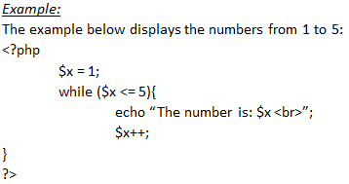
PHP While Loop
V . 2

Slide 79
PHP While Loop
Example Explained:
$x = 1; - Initialize the loop counter ($x), and set the start value to 1
$x <= 5 - Continue the loop as long as $x is less than or equal to 5
$x++; - Increase the loop counter value by 1 for each iteration
This example counts to 100 by tens:
<?php
$x = 0;
while ($x <= 100){
echo “The number is: $x <br>”;
x+=10;
}
?>
V . 2

Slide 80
PHP do While Loop
The do...while loop - Loops through a block of code once, and then repeats the loop as long as the specified condition is true.
Syntax:
do {
// Code to be executed;
} while (Condition is true);
V . 2

Slide 81
PHP do While Loop
Example:
The example below first sets a variable $x to 1 ($x = 1). Then, the do while loop will write some output, and then increment the variable $x with 1. Then the condition is checked (is $x less than, or equal to 5?), and the loop will continue to run as long as $x is less than, or equal to 5:
<?php
$x = 1;
do{
echo “The number is: $x <br>”;
x++;
} while($x <= 5);
?>
V . 2

Slide 82
PHP for Loop
The for loop - Loops through a block of code a specified number of times.
Syntax:
for (init counter; test counter; increment counter){
// Code to be executed for each iteration;
}
Parameters:
init counter: Initialize the loop counter value
test counter: Evaluated for each loop iteration. If it evaluates to TRUE, the loop continues. If it evaluates to FALSE, the loop ends.
increment counter: Increases the loop counter value
V . 2

Slide 83
PHP for Loop
Example:
The example below displays the numbers from 0 to 10
<?php
for($x = 0; $x <= 10; $x++){
echo “The number is: $x <br>”;
}
?>
V . 2

Slide 84
PHP foreach Loop
Syntax:
Foreach ($array as $value){
// Code to be executed
}
For every loop iteration, the value of the current array element is assigned to $value and the array pointer is moved by one, until it reaches the last array element.
V . 2

Slide 85
PHP foreach Loop
Example:
The following example will output the values of the given array ($colors):
<?php
$colors = array(“red”, “green”, “blue”, “yellow”);
foreach ($colors as $value){
echo “$value <br>”;
}
?>
V . 2

Slide 86
PHP foreach Loop
Example:
<?php
$ages= array(”Peter”=>”35”, “B3n”=>”37”, “Joe”=>”43”);
foreach ($ages as $x => $val){
echo “$x = $val <br>”;
}
?>
V . 2

Slide 87
PHP Functions
The real power of PHP comes from its functions.
PHP has more than 1000 built-in functions, and in addition you can create your own custom functions.
PHP has over 1000 built-in functions that can be called directly, from within a script, to perform a specific task.
PHP Built-in Functions
V . 2

Slide 88
PHP Functions
PHP User Defined Functions
Besides the built-in PHP functions, it is possible to create your own functions.
A function is a block of statements that can be used repeatedly in a program.
A function will not execute automatically when a page loads.
A function will be executed by a call to the function.
V . 2

Slide 89
PHP Functions
PHP User Defined Functions
Besides the built-in PHP functions, it is possible to create your own functions.
A function is a block of statements that can be used repeatedly in a program.
A function will not execute automatically when a page loads.
A function will be executed by a call to the function.
V . 2

Slide 90
PHP Functions
Create a User Defined Function in PHP
A user-defined function declaration starts with the word function:
Syntax:
function functionName() {
// Code to be executed;
}
Note: A function name must start with a letter or an underscore. Function
names are NOT case-sensitive.
Tip: Give the function a name that reflects what the function does!
V . 2

Slide 91
PHP Functions
In the example below, we create a function named "writeMsg()". The opening curly brace ( { ) indicates the beginning of the function code, and the closing curly brace ( } ) indicates the end of the function. The function outputs "Hello world!". To call the function, just write its name followed by brackets ():
Example:
<?php
functions writeMsg(){
echo “Hello World!”;
}
writeMsg(); // Call the function
?>
V . 2

Slide 92
PHP Functions Arguments
Information can be passed to functions through arguments. An argument is just like a variable.
Arguments are specified after the function name, inside the parentheses. You can add as many arguments as you want, just separate them with a comma.
The following example has a function with one argument ($fname). When the familyName() function is called, we also pass along a name (e.g. Jani), and the name is used inside the function, which outputs several different first names, but an equal last name
V . 2

Slide 93
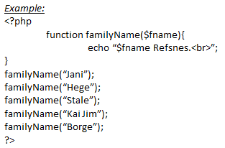
PHP Functions Arguments
V . 2

Slide 94
PHP Functions Arguments
The following example has a function with two arguments ($fname and $year):
Example:
<?php
function familyName($fname, $year){
echo “$fname Refsnes. Born in $year <br>”;
}
familyName (“Hege”, “1975”);
familyName (“Stale”, “1978”);
familyName (“Kai Jim”, “1983”);
?>
V . 2

Slide 95
PHP is a Loosely Types Language
In the example above, notice that we did not have to tell PHP which data type the variable is.
PHP automatically associates a data type to the variable, depending on its value. Since the data types are not set in a strict sense, you can do things like adding a string to an integer without causing an error.
In PHP 7, type declarations were added. This gives us an option to specify the expected data type when declaring a function, and by adding the strict declaration, it will throw a "Fatal Error" if the data type mismatches.
In the following example we try to send both a number and a string to the function without using strict
V . 2

Slide 96
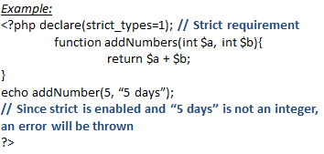
PHP is a Loosely Types Language
In the following example we try to send both a number and a string to the function, but here we have added the strict declaration:
V . 2

Slide 97
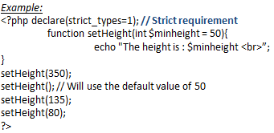
PHP Default Argument Value
The following example shows how to use a default parameter. If we call the function setHeight() without arguments it takes the default value as argument:
V . 2

Slide 98
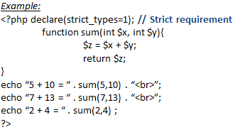
PHP Functions – Returning Values
To let a function return a value, use the return statement:
V . 2

Slide 99
PHP Return Type Declarations
PHP 7 also supports Type Declarations for the return statement. Like with the type declaration for function arguments, by enabling the strict requirement, it will throw a "Fatal Error" on a type mismatch.
To declare a type for the function return, add a colon ( : ) and the type right before the opening curly ( { )bracket when declaring the function.
In the following example we specify the return type for the function:
V . 2

Slide 100
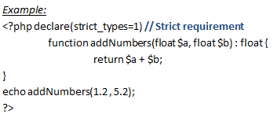
PHP Return Type Declarations
V . 2

Slide 101
Passing Arguments by Reference
In PHP, arguments are usually passed by value, which means that a copy of the value is used in the function and the variable that was passed into the function cannot be changed. When a function argument is passed by reference, changes to the argument also change the variable that was passed in. To turn a function argument into a reference, the & operator is used
V . 2

Slide 102
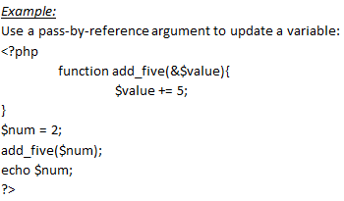
Passing Arguments by Reference
V . 2

Slide 103
PHP Arrays
An array stores multiple values in one single variable:
Example:
<?php
$cars = array(“volvo”, “BMW”, “Toyota”);
echo “I like “ . $cars[0] . “, “ . $cars[1] . “and ” . $cars[2] . “.”;
?>
V . 2

Slide 104
PHP Arrays
What is an Array?
An array is a special variable, which can hold more than one value at a time.
If you have a list of items (a list of car names, for example), storing the cars in single variables could look like this:
$cars1 = "Volvo";
$cars2 = "BMW";
$cars3 = "Toyota";
However, what if you want to loop through the cars and find a specific one? And what if you had not 3 cars, but 300?
The solution is to create an array!
An array can hold many values under a single name, and you can access the values by referring to an index number.
V . 2

Slide 105
PHP Arrays
Creating an Array in PHP
In PHP, the array() function is used to create an array:
array();
In PHP, there are three types of arrays:
Indexed arrays - Arrays with a numeric index
Associative arrays - Arrays with named keys
Multidimensional arrays - Arrays containing one or more arrays
V . 2

Slide 106
PHP Arrays
Get The Length of an Array – The count() Function
The count() function is used to return the length (the number of elements) of an array:
Example:
<?php
$cars = array(“volvo”, “BMW”, “Toyota”);
echo count($cars);
?>
V . 2

Slide 107
PHP Arrays
PHP Indexed Arrays
There are two ways to create indexed arrays: The index can be assigned automatically (index always starts at 0), like this:
$cars = array("Volvo", "BMW", "Toyota");
or the index can be assigned manually:
$cars[0] = "Volvo";
$cars[1] = "BMW";
$cars[2] = "Toyota";
The following example creates an indexed array named $cars, assigns three elements to it, and then prints a text containing the array values:
V . 2

Slide 108
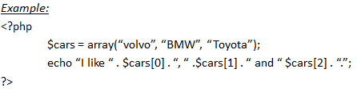
PHP Arrays
PHP Indexed Arrays
V . 2

Slide 109
Loop Through an Indexed Array
To loop through and print all the values of an indexed array, you could use a for loop, like this:
Example:
<?php
$cars = array(“volvo”, “BMW”, “Toyota”);
$arrlength = count($cars);
for ($x = 0; $x < $arrlength; $x++){
echo $cars[$x];
echo “<br>”;
}
?>
V . 2

Slide 110
PHP Arrays
Loop Through an Indexed Array
To loop through and print all the values of an indexed array, you could use a for loop, like this:
Example:
<?php
$cars = array(“volvo”, “BMW”, “Toyota”);
$arrlength = count($cars);
for ($x = 0; $x < $arrlength; $x++){
echo $cars[$x];
echo “<br>”;
}
?>
V . 2

Slide 111
PHP Arrays
PHP Associative Arrays
Associative arrays are arrays that use named keys that you assign to them. There are two ways to create an associative array:
$age = array(“Peter”=>”35” , “Ben”=>”37” , “Joe”=>”43”);
Or:
$age[“Peter”] = “35”;
$age[“Ben”] = “37”;
$age[“Joe”] = “43”;
V . 2

Slide 112
PHP Arrays
Loop Through an Associative Array
To loop through and print all the values of an associative array, you could use a foreach loop, like this:
Example:
<?php
$age = array(“Peter”=>”35” , “Ben”=>”37”, “Joe”=>”43”);
Foreach($age as $x => $x_value){
echo “Key=“ . $x . “, Value=“ . $x_vlaue;
echo “<br>”;
}
?>
V . 2

Slide 113
PHP Arrays
PHP – Multidimensional Arrays
A multidimensional array is an array containing one or more arrays.
PHP supports multidimensional arrays that are two, three, four, five, or more levels deep. However, arrays more than three levels deep are hard to manage for most people.
The dimension of an array indicates the number of indices you need to select an element.
For a two-dimensional array you need two indices to select an element
For a three-dimensional array you need three indices to select an element
A two-dimensional array is an array of arrays (a three-dimensional array is an array of arrays of arrays).
V . 2

Slide 114
PHP Arrays
PHP – Multidimensional Arrays
First, task a look at the following table: We can store the data from the table above in a two-dimensional array, like this:
Name | Stock | Sold
Volvo | 22 | 18
BMW | 15 | 13
Saab | 5 | 2
Land Rover | 17 | 15
V . 2

Slide 115
PHP Arrays
PHP – Multidimensional Arrays
$cars = array(
array(“Volvo” , 22 , 18),
array(“BMW” , 15, 13),
array(“Sabb” , 5 , 2),
array(“Land Rover” , 17, 15)
);
Now the two-dimensional $cars array contains four arrays, and it has two indices: row and column.
To get access to the elements of the $cars array we must point to the two indices (row and column):
V . 2

Slide 116
PHP Arrays
PHP – Multidimensional Arrays
Example:
<?php
echo $cars[0][0].”: In stock: “ . $cars[0][1]. “, sold” .$cars[0][2]. “.<br>”;
echo $cars[1][0].”: In stock: “ . $cars[1][1]. “, sold” .$cars[1][2]. “.<br>”;
echo $cars[2][0].”: In stock: “ . $cars[2][1]. “, sold” .$cars[2][2]. “.<br>”;
echo $cars[3][0].”: In stock: “ . $cars[3][1]. “, sold” .$cars[3][2]. “.<br>”;
?>
We can also put a for loop inside another for loop to get the elements of the $cars array (we still have to point to the two indices):
V . 2

Slide 117
PHP Arrays
PHP – Multidimensional Arrays
Example:
<?php
For($row = 0; $row < 4; $row++){
echo “<p><b>Row number $row</b></p>”;
echo “<ul”>;
for($col = 0; $col < 3; $col++){
echo “<li” . $cars[$row][$col].”</li>”;
}
Echo “</ul>”;
}
?>
V . 2

Slide 118
PHP Sorting Arrays
The elements in an array can be sorted in alphabetical or numerical order, descending or ascending.
PHP – Sort Functions For Arrays
In this chapter, we will go through the following PHP array sort functions:
sort() - sort arrays in ascending order
rsort() - sort arrays in descending order
asort() - sort associative arrays in ascending order, according to the value
ksort() - sort associative arrays in ascending order, according to the key
arsort() - sort associative arrays in descending order, according to the value
krsort() - sort associative arrays in descending order, according to the key
V . 2

Slide 119
PHP Sorting Arrays
Sort Array in Ascending Order-sort()
The following example sorts the elements of the $cars array in ascending alphabetical order:
Example:
<?php
$cars = array(“volvo” , “BMW” , “Toyota”);
sort($cars);
?>
V . 2

Slide 120
PHP Sorting Arrays
Sort Array in Descending Order-sort()
The following example sorts the elements of the $cars array in descending alphabetical order:
Example:
<?php
$cars = array(“volvo” , “BMW” , “Toyota”);
rsort($cars);
?>
V . 2

Slide 121
PHP Sorting Arrays
Sort Array in (Ascending-Order) , According to Value – asort()
The following example sorts an associative array in ascending order, according to the value:
Example:
<?php
$age = array((“Peter”=>”35” , “Ben”=>”37”, “Joe”=>”43”);
asort($age);
?>
V . 2

Slide 122
PHP Sorting Arrays
Sort Array in (Ascending-Order) , According to Key– ksort()
The following example sorts an associative array in ascending order, according to the key:
Example:
<?php
$age = array((“Peter”=>”35” , “Ben”=>”37”, “Joe”=>”43”);
ksort($age);
?>
V . 2

Slide 123
PHP Sorting Arrays
Sort Array in (Descending-Order) , According to Value– asort()
The following example sorts an associative array in descending order, according to the value:
Example:
<?php
$age = array((“Peter”=>”35” , “Ben”=>”37”, “Joe”=>”43”);
arsort($age);
?>
V . 2

Slide 124
PHP Sorting Arrays
Sort Array in (Descending-Order) , According to Key– ksort()
The following example sorts an associative array in descending order, according to the key:
Example:
<?php
$age = array((“Peter”=>”35” , “Ben”=>”37”, “Joe”=>”43”);
krsort($age);
?>
V . 2

Slide 125
PHP Global Variables - Superglobals
Some predefined variables in PHP are "superglobals", which means that they are always accessible, regardless of scope - and you can access them from any function, class or file without having to do anything special.
The PHP superglobal variables are:
$GLOBALS
$_SERVER
$_REQUEST
$_POST
$_GET
$_FILES
$_ENV
$_COOKIE
$_SESSION
V . 2

Slide 126
$GLOBALS
Super global variables are built-in variables that are always available in all scopes.
$GLOBALS is a PHP super global variable which is used to access global variables from anywhere in the PHP script (also from within functions or methods).
PHP stores all global variables in an array called $GLOBALS[index]. The index holds the name of the variable.
The example below shows how to use the super global variable $GLOBALS:
V . 2

Slide 127
$GLOBALS
Example:
<?php
$x = 75;
$y = 25;
function addition(){
$GLOBALS[‘z’] = $GLOBALS[‘x’] + $GLOBALS[‘y’];
}
addition();
echo $z;
?>
V . 2

Slide 128
$_SERVER
$_SERVER is a PHP super global variable which holds information about headers, paths, and script locations.
The example below shows how to use some of the elements in $_SERVER:
Example:
<?php
echo $_SERVER[‘PHP_SELF’];
echo “<br>”;
echo $_SERVER[‘SERVER_NAME’];
echo “<br>”;
echo $_SERVER[‘HTTP_HOST’];
echo “<br>”;
echo $_SERVER[‘HTTP_USER_AGENT’];
echo “<br>”;
echo $_SERVER[‘SCRIPT_NAME’];
?>
V . 2

Slide 129
$_SERVER
Element/Code | Description
$_SERVE[‘PHP_SELF’] | Returns the filename of the currently executing script
$_SERVE[‘GATEWAY_INTRFACE’] | Returns the version of the Common Gateway Interface (CGI) the server is using
$_SERVE[‘SERVE_ADDR’] | Returns the IP address of the host server
V . 2

Slide 130
$_SERVER
Element/Code | Description
$_SERVER['HTTP_ACCEPT'] | Returns the Accept header from the current request
$_SERVER['HTTP_ACCEPT_CHARSET'] | Returns the Accept_Charset header from the current request (such as utf-8,ISO8859-1)
$_SERVER['HTTP_HOST'] | Returns the Host header from the current request
V . 2

Slide 131
$_SERVER
Element/Code | Description
$_SERVER['HTTP_REFERER'] | Returns the complete URL of the current page (not reliable because not all user-agents support it)
$_SERVER['HTTPS'] | Is the script queried through a secure HTTP protocol
$_SERVER['REMOTE_ADDR'] | Returns the IP address from where the user is viewing the current page
V . 2

Slide 132
$_SERVER
Element/Code | Description
$_SERVER['REMOTE_HOST'] | Returns the Host name from where the user is viewing the current page
$_SERVER['REMOTE_PORT'] | Returns the port being used on the user's machine to communicate with the web server
$_SERVER['SCRIPT_FILENAME'] | Returns the absolute pathname of the currently executing script
V . 2

Slide 133
$_SERVER
Element/Code | Description
$_SERVER['SERVER_ADMIN'] | RReturns the value given to the SERVER_ADMIN directive in the web server configuration file (if your script runs on a virtual host, it will be the value defined for that virtual host) (such as someone@w3schools.com)
$_SERVER['SERVER_PORT'] | Returns the port on the server machine being used by the web server for communication (such as 80)
V . 2

Slide 134
$_SERVER
Element/Code | Description
$_SERVER['SERVER_SIGNATURE'] | Returns the server version and virtual host name which are added to server-generated pages
$_SERVER['PATH_TRANSLATED'] | Returns the path of the current script
$_SERVER['SCRIPT_URI'] | Returns the URI of the current page
V . 2

Slide 135
$_Request
PHP $_REQUEST is a PHP super global variable which is used to collect data after submitting an HTML form.
The example below shows a form with an input field and a submit button. When a user submits the data by clicking on "Submit", the form data is sent to the file specified in the action attribute of the tag. In this example, we point to this file itself for processing form data. If you wish to use another PHP file to process form data, replace that with the filename of your choice. Then, we can use the super global variable $_REQUEST to collect the value of the input field
V . 2

Slide 136
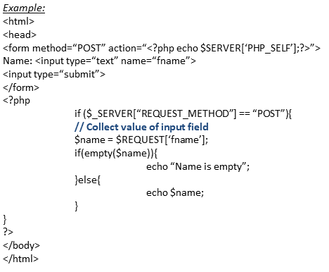
$_Request
V . 2

Slide 137
$_POST
PHP $_POST is a PHP super global variable which is used to collect form data after submitting an HTML form with method="post". $_POST is also widely used to pass variables.
The example below shows a form with an input field and a submit button. When a user submits the data by clicking on "Submit", the form data is sent to the file specified in the action attribute of the tag. In this example, we point to the file itself for processing form data. If you wish to use another PHP file to process form data, replace that with the filename of your choice. Then, we can use the super global variable $_POST to collect the value of the input field:
V . 2

Slide 138
$_POST
V . 2

Slide 139
$_GET
PHP $_GET is a PHP super global variable which is used to collect form data after submitting an HTML form with method="get". $_GET can also collect data sent in the URL. Assume we have an HTML page that contains a hyperlink with parameters:
<html>
<body>
<a href=“test_get.php?subject=PHP&web=W3SCHOOLS.com”>Test $GET</a>
</body>
</html>
When a user clicks on the link "Test $GET", the parameters "subject" and "web" are sent to "test_get.php", and you can then access their values in "test_get.php" with $_GET. The example below shows the code in "test_get.php":
V . 2

Slide 140
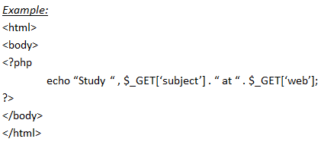
$_GET
V . 2

Slide 141
PHP Form Handling
The PHP superglobals $_GET and $_POST are used to collect form-data.
PHP - A Simple HTML Form
The example below displays a simple HTML form with two input fields and a submit button:
Example:
<html>
<body>
<form action=“welcome.php” method=“POST”>
Name: <input type=“text” name=”name”><br>
Email: <input type=“email” name=”email”><br>
<input type=“submit”>
</form>
</body>
</html>
V . 2

Slide 142
PHP Form Handling
When the user fills out the form above and clicks the submit button, the form data is sent for processing to a PHP file named "welcome.php".
The form data is sent with the HTTP POST method.
To display the submitted data you could simply echo all the variables. The "welcome.php" looks like this:
<html>
<body>
Welcome <?php echo $_POST[“name”]; ?> <br>
Your email address is: <?php echo $_POST[“email”]; ?>
</body>
</html>
The output could be something like this:
Welcome Your email address is: John.doe@example.com
V . 2

Slide 143
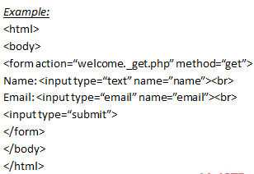
PHP Form Handling
V . 2

Slide 144
GET VS. POST
Both GET and POST create an array (e.g. array( key1 => value1, key2 => value2, key3 => value3, ...)). This array holds key/value pairs, where keys are the names of the form controls and values are the input data from the user.
Both GET and POST are treated as $_GET and $_POST. These are superglobals, which means that they are always accessible, regardless of scope - and you can access them from any function, class or file without having to do anything special.
$_GET is an array of variables passed to the current script via the URL parameters.
$_POST is an array of variables passed to the current script via the HTTP POST method.
V . 2

Slide 145
GET VS. POST
When to use GET?
Information sent from a form with the GET method is visible to everyone (all variable names and values are displayed in the URL). GET also has limits on the amount of information to send. The limitation is about 2000 characters. However, because the variables are displayed in the URL, it is possible to bookmark the page. This can be useful in some cases.
GET may be used for sending non-sensitive data.
Note: GET should NEVER be used for sending passwords or other sensitive information!
V . 2

Slide 146
GET VS. POST
When to use POST?
Information sent from a form with the POST method is invisible to others (all names/values are embedded within the body of the HTTP request) and has no limits on the amount of information to send. Moreover POST supports advanced functionality such as support for multi-part binary input while uploading files to server.
However, because the variables are not displayed in the URL, it is not possible to bookmark the page.
Developers prefer POST for sending form data.
Next, lets see how we can process PHP forms the secure way!
V . 2

Slide 147
PHP Date and Time
The PHP date() function is used to format a date and/or a time.
The PHP Date() Function
The PHP date() function formats a timestamp to a more readable date and time.
Syntax:
date(format, timestamp)
V . 2

Slide 148
PHP Date and Time
Parameter | Description
Format | Required. Specifies the format of the timestamp
timestamp | Optional. Specifies a timestamp. Default is the current date and time
V . 2

Slide 149
PHP Date and Time
Get a Date:
The required format parameter of the date() function specifies how to format the date (or time).
Here are some characters that are commonly used for dates:
d - Represents the day of the month (01 to 31)
m - Represents a month (01 to 12)
Y - Represents a year (in four digits)
l (lowercase 'L') - Represents the day of the week
Other characters, like"/", ".", or "-" can also be inserted between the characters to add additional formatting.
The example below formats today's date in three different ways:
V . 2

Slide 150
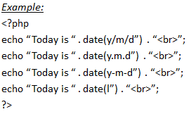
PHP Date and Time
V . 2

Slide 151
PHP Date and Time
Get a Time:
Here are some characters that are commonly used for times:
H - 24-hour format of an hour (00 to 23)
h - 12-hour format of an hour with leading zeros (01 to 12)
i - Minutes with leading zeros (00 to 59)
s - Seconds with leading zeros (00 to 59)
a - Lowercase Ante meridiem and Post meridiem (am or pm)
The example below outputs the current time in the specified format:
V . 2

Slide 152
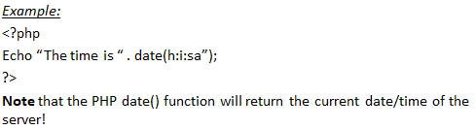
PHP Date and Time
Get a Time:
V . 2

Slide 153
PHP Date and Time
Get Your Time Zone:
If the time you got back from the code is not correct, it's probably because your server is in another country or set up for a different timezone.
So, if you need the time to be correct according to a specific location, you can set the timezone you want to use.
The example below sets the timezone to "America/New_York", then outputs the current time in the specified format:
V . 2

Slide 154
PHP Date and Time
Get Your Time Zone:
V . 2

Slide 155
PHP Date and Time
Create a Date With mktime()
The optional timestamp parameter in the date() function specifies a timestamp. If omitted, the current date and time will be used (as in the examples above).
The PHP mktime() function returns the Unix timestamp for a date. The Unix timestamp contains the number of seconds between the Unix Epoch (January 1 1970 00:00:00 GMT) and the time specified
V . 2

Slide 156
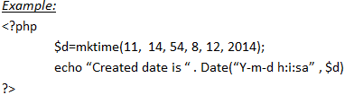
PHP Date and Time
Syntax:
mktime(hour, minute, second, month, day, year)
The example below creates a date and time with the date() function from a number of parameters in the mktime() function:
V . 2

Slide 157
PHP Date and Time
Create a Date Form a string with strtotime()
The PHP strtotime() function is used to convert a human readable date string into a Unix timestamp (the number of seconds since January 1 1970 00:00:00 GMT).
Syntax:
strtotime(time , now)
V . 2

Slide 158
PHP Date and Time
The example below creates a date and time from the strtotime() function:
Example:
<?php
$d=strtotime(“10:30pm April 15 2014”);
echo “Created date is “ . Date()”Y-m-d h:i:sa “, $d);
?>
V . 2

Slide 159
PHP Date and Time
PHP is quite clever about converting a string to a date, so you can put in various values:
Example:
<?php
$d=strtotime(“tomorrow”);
echo date(“Y-m-d h:i:sa” , $d) . “<br>”;
$d=strtotime(“next Saturday”);
echo date(“Y-m-d h:i:sa” , $d) . “<br>”;
$d=strtotime(“+3 Months”);
echo date(“Y-m-d h:i:sa” , $d) . “<br>”;
?>
V . 2

Slide 160
PHP Date and Time
However, strtotime() is not perfect, so remember to check the strings you put in there.
More Date Examples:
The example below outputs the dates for the next six Saturdays:
Example:
<?php
$statdate = strtotime(“Saturday”);
$enddate = strtotime(“+6 weeks” , $startdate);
while ($startdate < $endddate){
echo date(“M d”, $startdate) . “<br>”;
$startdate = strtotime(“+1 week” , $startdate)’
}
?>
V . 2

Slide 161
PHP Date and Time
The example below outputs the number of days until 4th of July:
Example:
<?php
$d1 = strtotime(“July 04”);
$d2 = ceil(($d1-time())/60/60/24)’
echo “There are “ .$d2 . “ days until 4th of July”;
?>
V . 2

Slide 162
PHP Include Files
The include (or require) statement takes all the text/code/markup that exists in the specified file and copies it into the file that uses the include statement. Including files is very useful when you want to include the same PHP, HTML, or text on multiple pages of a website.
V . 2

Slide 163
PHP Include Files
PHP include and require Statements
It is possible to insert the content of one PHP file into another PHP file (before the server executes it), with the include or require statement.
The include and require statements are identical, except upon failure:
require will produce a fatal error (E_COMPILE_ERROR) and stop the script
include will only produce a warning (E_WARNING) and the script will continue
So, if you want the execution to go on and show users the output, even if the include file is missing, use the include statement. Otherwise, in case of FrameWork, CMS, or a complex PHP application coding, always use the require statement to include a key file to the flow of execution. This will help avoid compromising your application's security and integrity, just in-case one key file is accidentally missing.
V . 2

Slide 164
PHP Include Files
Including files saves a lot of work. This means that you can create a standard header, footer, or menu file for all your web pages. Then, when the header needs to be updated, you can only update the header include file.
Syntax:
Include ‘filename’;
OR
Require ‘filename’;
V . 2

Slide 165
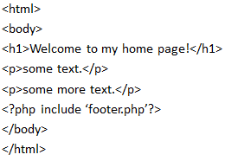
PHP Include Files
V . 2

Slide 166
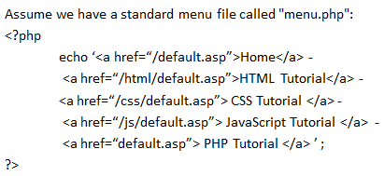
PHP Include Files
V . 2

Slide 167
PHP Include Files
All pages in the Web site should use this menu file. Here is how it can be done (we are using a element so that the menu easily can be styled with CSS later):
Example:
<html>
<body>
<div class=“menu”>
<?php include ‘menu.php’?>
</div>
<h1>Welcome to my home page!</h1>
<p>some text.</p>
<p>some more text.</p>
</body>
</html>
V . 2

Slide 168
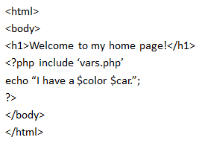
PHP Include Files
Assume we have a file called "vars.php", with some variables defined:
<?php
$color = ‘red’;
$car = ‘BMW’;
?>
Then, if we include the "vars.php" file, the variables can be used in the calling file:
V . 2

Slide 169
PHP Include VS. Reuire
The require statement is also used to include a file into the PHP code. However, there is one big difference between include and require; when a file is included with the include statement and PHP cannot find it, the script will continue to execute:
<html>
<body>
<h1>Welcome to my home page!</h1>
<?php include ‘noFikeExists.php’
echo “I have a $color $car.”;
?>
</body>
</html>
V . 2

Slide 170
PHP Include VS. Reuire
If we do the same example using the require statement, the echo statement will not be executed because the script execution dies after the require statement returned a fatal error:
Example:
<html>
<body>
<h1>Welcome to my home page!</h1>
<?php require ‘noFilesExists.php’
echo “I have a $color $car.”;
?>
</body>
</html>
V . 2

Slide 171
PHP Include VS. Reuire
Use require when the file is required by the application. Use include when the file is not required and application should continue when file is not found
V . 2

Slide 172
PHP Tip – Automatic Copyright Year
Use the date() function to automatically update the copyright year on your website:
Example:
&copy; 2021-<?php echo date(“Y”);?>
V . 2

Slide 173
PHP Tip – Automatic Copyright Year
Use the date() function to automatically update the copyright year on your website:
Example:
&copy; 2021-<?php echo date(“Y”);?>
V . 2

Slide 174
PHP Cookies
What is a Cookie?
A cookie is often used to identify a user. A cookie is a small file that the server embeds on the user's computer. Each time the same computer requests a page with a browser, it will send the cookie too. With PHP, you can both create and retrieve cookie values.
V . 2

Slide 175
PHP Cookies
Create Cookies with PHP?
A cookie is created with the setcookie() function.
Syntax:
setcookie(name, value, expire, path, domain, secure, httponly);
Only the name parameter is required. All other parameters are optional
V . 2

Slide 176
PHP Cookies
Create/Redirect a Cookie
The following example creates a cookie named "user" with the value "John Doe". The cookie will expire after 30 days (86400 * 30). The "/" means that the cookie is available in entire website (otherwise, select the directory you prefer). We then retrieve the value of the cookie "user" (using the global variable $_COOKIE). We also use the isset() function to find out if the cookie is set:
V . 2

Slide 177
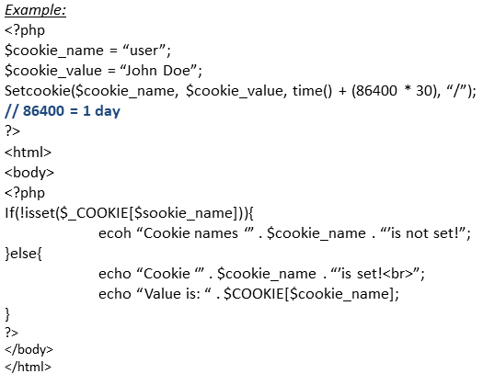
PHP Cookies
Create/Redirect a Cookie
V . 2

Slide 178
PHP Cookies
Create/Redirect a Cookie
Note: The setcookie() function must appear BEFORE the tag. Note: The value of the cookie is automatically URLencoded when sending the cookie, and automatically decoded when received (to prevent URLencoding, use setrawcookie() instead).
V . 2

Slide 179
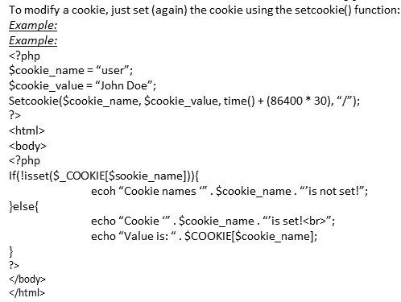
PHP Cookies
PHP Modify a Cookie Value
V . 2

Slide 180
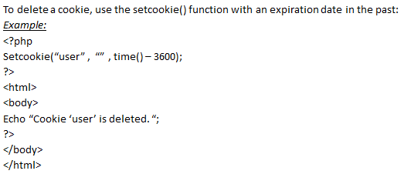
PHP Cookies
Delete Cookie
V . 2

Slide 181
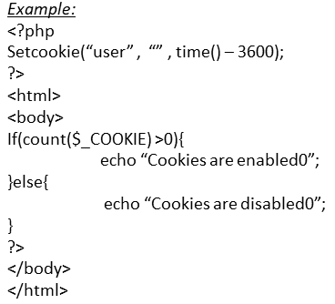
PHP Cookies
Check if Cookie are Enabled
The following example creates a small script that checks whether cookies are enabled. First, try to create a test cookie with the setcookie() function, then count the $_COOKIE array variable
V . 2

Slide 182
PHP Sessions
A session is a way to store information (in variables) to be used across multiple pages. Unlike a cookie, the information is not stored on the users computer.
What is a PHP Session?
When you work with an application, you open it, do some changes, and then you close it. This is much like a Session. The computer knows who you are. It knows when you start the application and when you end. But on the internet there is one problem: the web server does not know who you are or what you do, because the HTTP address doesn't maintain state.
Session variables solve this problem by storing user information to be used across multiple pages (e.g. username, favorite color, etc). By default, session variables last until the user closes the browser.
So; Session variables hold information about one single user, and are available to all pages in one application.
Tip: If you need a permanent storage, you may want to store the data in a database.
V . 2

Slide 183
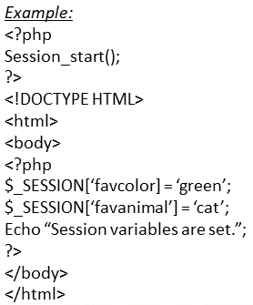
PHP Sessions
Start a PHP Session A session is started with the session_start() function. Session variables are set with the PHP global variable: $_SESSION. Now, let's create a new page called "demo_session1.php". In this page, we start a new PHP session and set some session variables:
V . 2

Slide 184
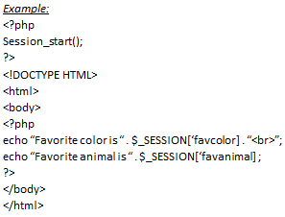
PHP Sessions
V . 2

Slide 185
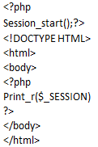
PHP Sessions
Another way to show all the session variable values for a user session is to run the following code:
V . 2

Slide 186
PHP Sessions
How does it work? How does it know it's me? Most sessions set a user-key on the user's computer that looks something like this: 765487cf34ert8dede5a562e4f3a7e12. Then, when a session is opened on another page, it scans the computer for a user-key. If there is a match, it accesses that session, if not, it starts a new session.
Modify a PHP Session Variable
To change a session variable, just overwrite it:
V . 2

Slide 187
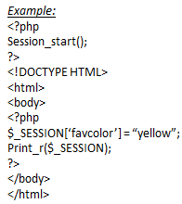
PHP Sessions
V . 2

Slide 188
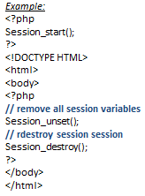
Destroy a PHP Sessions
To remove all global session variables and destroy the session, use session_unset() and session_destroy():
V . 2

Slide 189
Thank You!

